Slide 1
Wheel of Retailing:

Slide 2
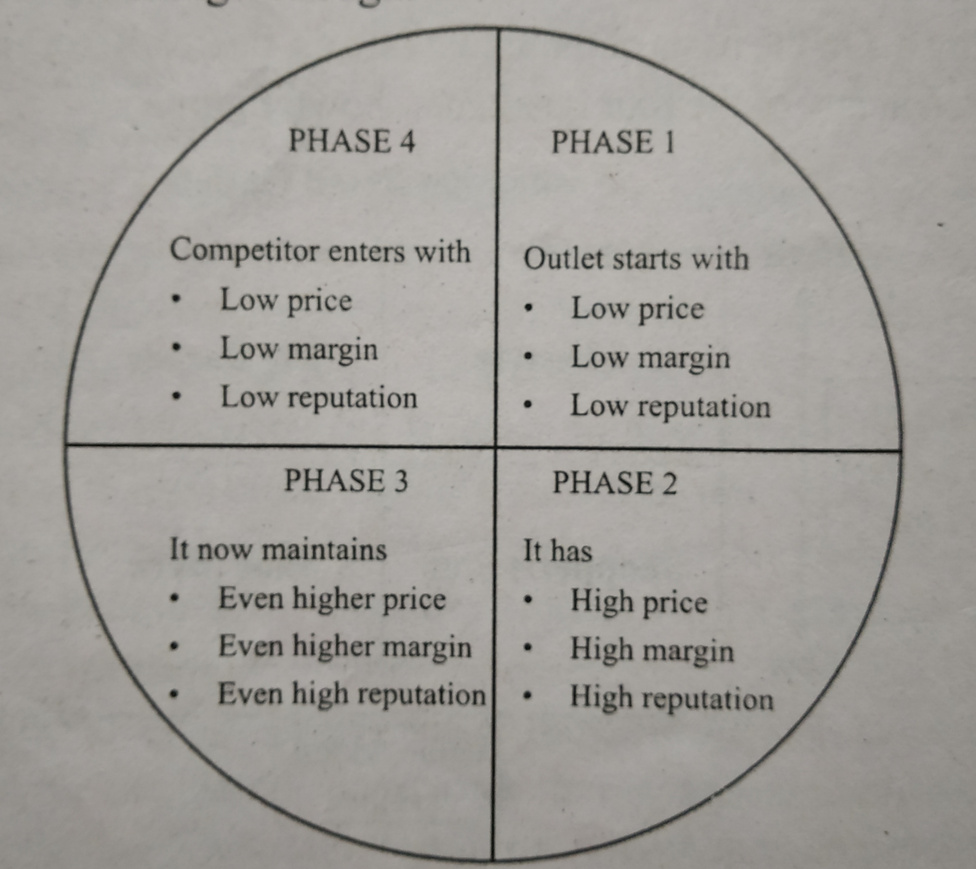

Slide 3
Step 1: Entering establishing in the market:
The new retailers often enter the market place with low prices as well as low profit margins and sometimes low status.

Slide 4
Step 2: Expanding in the market:
With the passage of time and while they gain more experience of the market, these retailer businesses strive to broaden their customer base and increase sales, gain higher profit margin as well as acquiring a significant market share.

Slide 5
Step 3: High margin stabilized business:
In this stage of the wheel of retailing, the company is already in an established position and hence the rates are enough to get a decent margin.

Slide 6
Step 4: The entry by another challenging retail competitors
As the retailer moves to the better market location with high quality products and target another segment its operations becomes more expensive.

